Slide 1


Slide 2
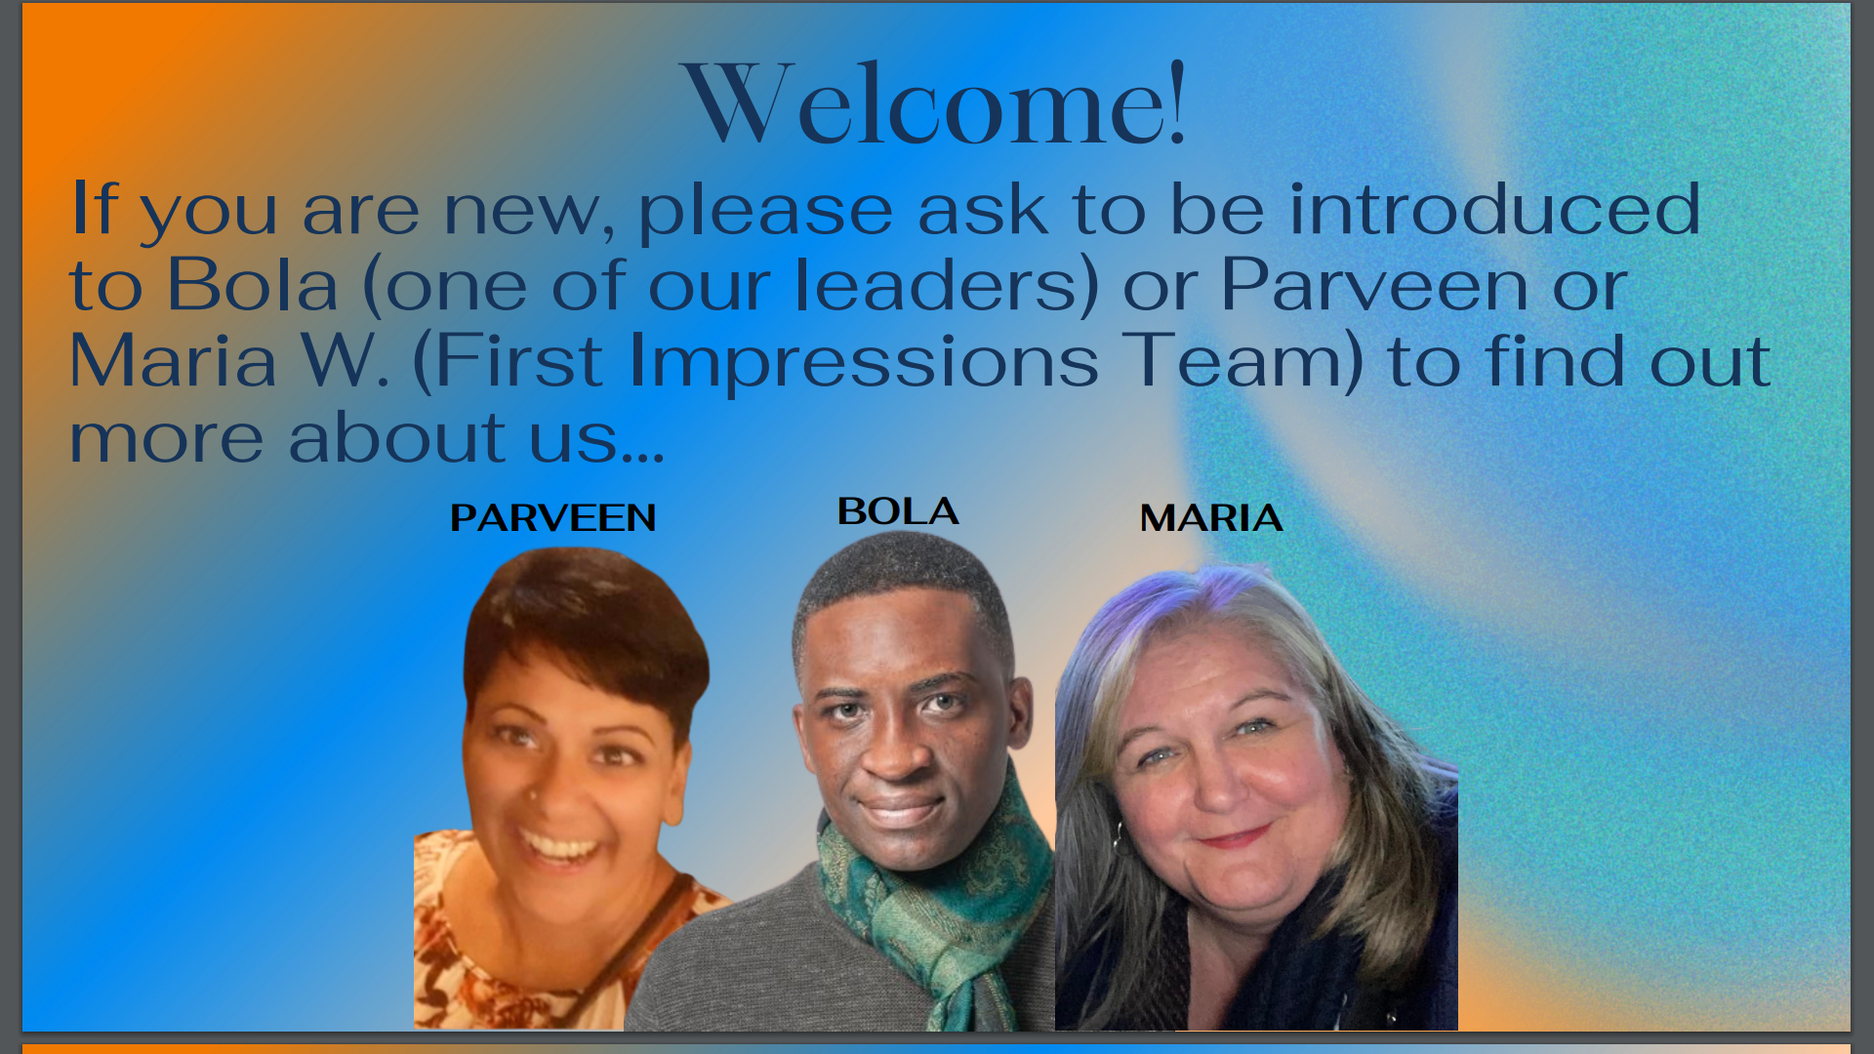

Slide 3


Slide 4


Slide 5


Slide 6
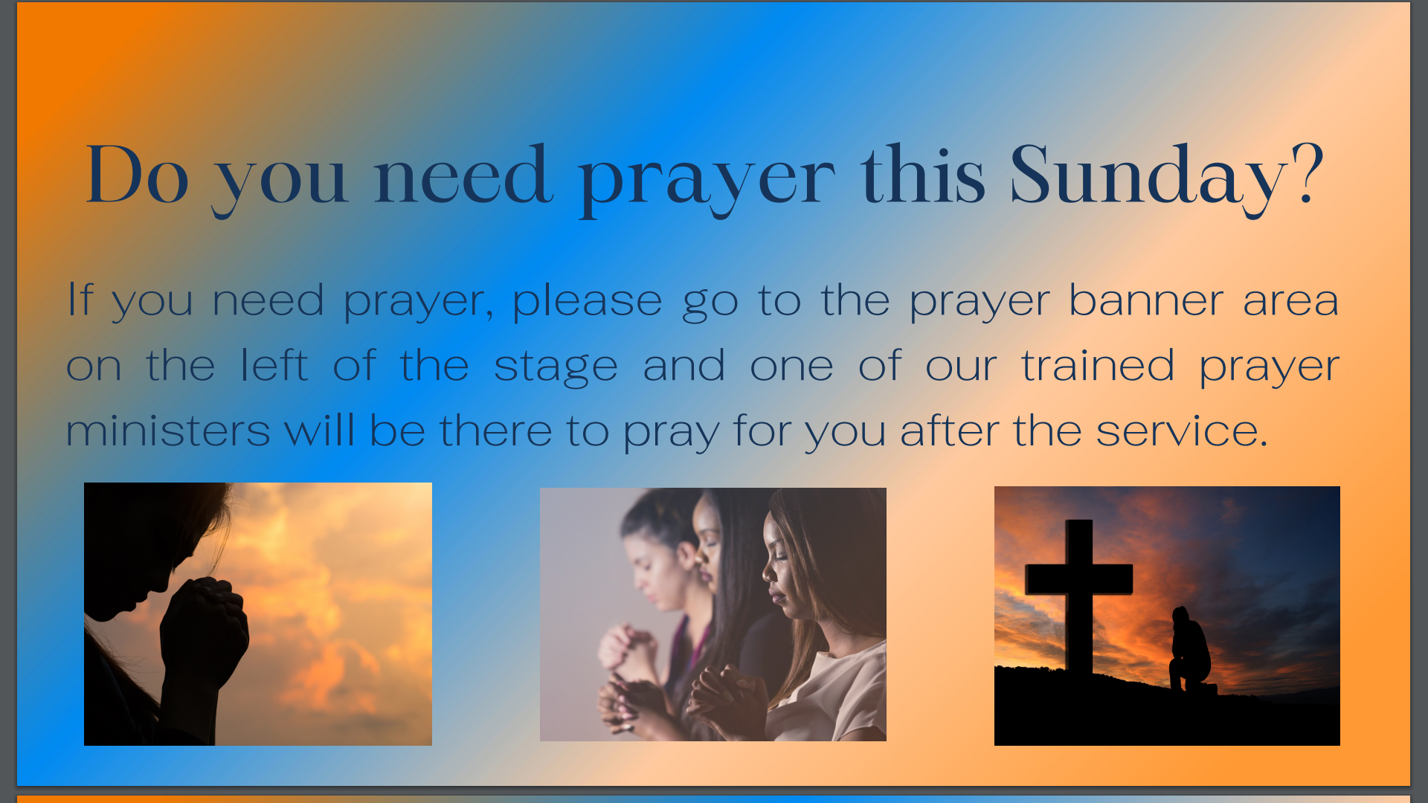

Slide 7


Slide 8
Cornerstone City Church Peninsula Plus Community Hoo Are Ya
3rd March 2024

Slide 9


Slide 10
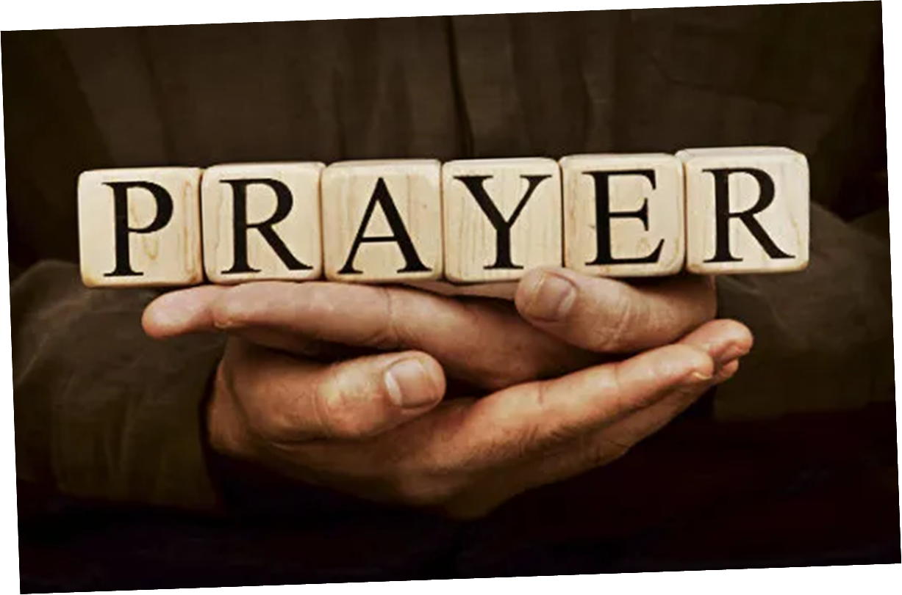

Slide 11


Slide 12
Show Your Power
CCLI Song # 861891
Kevin Prosch
© 1991 Mercy / Vineyard Publishing (Admin. by Integrity Music Ltd)
For use solely with the SongSelect® Terms of Use. All rights reserved. www.ccli.com
CCLI Licence No. 33265

Slide 13
1/4
Well He is the Lord He reigns on high
He is the Lord
Spoke into the darkness created the light
He is the Lord
Who is like unto Him never ending in days
He is the Lord
And He comes in power when we call on His name
He is the Lord

Slide 14
2/4
Show Your power oh Lord our God
Show Your power oh Lord our God
Oh Lord our God

Slide 15
3/4
Your gospel oh Lord is the hope for our nation
You are the Lord
It's the power of God for our salvation
You are the Lord
We ask not for riches but look to the cross
You are the Lord
And for our inheritance give us the lost
You are the Lord

Slide 16
4/4
Show Your power oh Lord our God
Show Your power oh Lord our God
Oh Lord our God

Slide 17
Hosanna (Praise Is Rising)
CCLI Song # 4662491
Brenton Brown | Paul Baloche
© 2005, 2006 Integrity's Hosanna! Music (Admin. by Integrity Music Ltd)
Thankyou Music (Admin. by Integrity Music Ltd)
For use solely with the SongSelect® Terms of Use. All rights reserved. www.ccli.com
CCLI Licence No. 33265

Slide 18
1/6
Praise is rising
Eyes are turning to You
We turn to You
Hope is stirring
Hearts are yearning for You
We long for You

Slide 19
2/6
‘Cause when we see You
We find strength to face the day
In Your presence
All our fears are washed away
(Washed away)

Slide 20
3/6
Hosanna Hosanna
You are the God who saves us
Worthy of all our praises
Hosanna Hosanna
Come have Your way among us
We welcome You here Lord Jesus

Slide 21
4/6
Hear the sound of
Hearts returning to You
We turn to You
In Your Kingdom
Broken lives are made new
You make us new

Slide 22
5/6
‘Cause when we see You
We find strength to face the day
In Your presence
All our fears are washed away
(Washed away)

Slide 23
6/6
Hosanna Hosanna
You are the God who saves us
Worthy of all our praises
Hosanna Hosanna
Come have Your way among us
We welcome You here Lord Jesus

Slide 25
Holy Forever
CCLI Song # 7201044
Brian Johnson | Chris Tomlin | Jason Ingram | Jenn Johnson | Phil Wickham
© Phil Wickham Music (Admin. by / Small Stone Media BV, Holland (Admin. in the UK/Eire by Song Solutions www.songsolutions.org))
Simply Global Songs (Admin. by / Small Stone Media BV, Holland (Admin. in the UK/Eire by Song Solutions www.songsolutions.org))
Capitol CMG Paragon (Admin. by Capitol CMG Publishing)
S. D. G. Publishing (Admin. by Capitol CMG Publishing)
Be Essential Songs (Admin. by Essential Music Publishing LLC)
My Magnolia Music (Admin. by Essential Music Publishing LLC)
Bethel Music Publishing (Admin. by Song Solutions)
Brian and Jenn Publishing (Admin. by Song Solutions)
For use solely with the SongSelect® Terms of Use. All rights reserved. www.ccli.com
CCLI Licence No. 33265

Slide 26
1/10
A thousand generations falling down in worship
To sing the song of ages to the Lamb
And all who've gone before us
And all who will believe
Will sing the song of ages to the Lamb

Slide 27
2/10
(Jesus) Your name is the highest
Your name is the greatest
Your name stands above them all
All thrones and dominions
All powers and positions
Your name stands above them all

Slide 28
3/10
And the angels cry Holy
All creation cries Holy
You are lifted high Holy
Holy forever

Slide 29
4/10
If you've been forgiven and if you've been redeemed
Sing the song forever to the Lamb
If you walk in freedom and if you bear His name
Sing the song forever to the Lamb
We'll sing the song forever and amen

Slide 30
5/10
And the angels cry Holy
All creation cries Holy
You are lifted high Holy
Holy forever

Slide 31
6/10
Hear Your people sing Holy
To the King of Kings Holy
You will always be Holy
Holy forever

Slide 32
7/10
(Jesus) Your name is the highest
Your name is the greatest
Your name stands above them all
All thrones and dominions
All powers and positions
Your name stands above them all

Slide 33
8/10
And the angels cry Holy
All creation cries Holy
You are lifted high Holy
Holy forever

Slide 34
9/10
Hear Your people sing Holy
To the King of Kings Holy
You will always be Holy
Holy forever

Slide 35
10/10
You will always be Holy
Holy forever

Slide 37
Who You Say I am
CCLI Song # 7102401
Ben Fielding | Reuben Morgan
© 2017 Hillsong Music Publishing Australia
For use solely with the SongSelect® Terms of Use. All rights reserved. www.ccli.com
CCLI License # 33265

Slide 38
1/6
Who am I that the highest King
Would welcome me
I was lost but He brought me in
Oh His love for me
Oh His love for me

Slide 39
2/6
Who the Son sets free
Oh is free indeed
I'm a child of God
Yes I am

Slide 40
3/6
Free at last
He has ransomed me
His grace runs deep
While I was a slave to sin
Jesus died for me
Yes He died for me

Slide 41
4/6
Who the Son sets free
Oh is free indeed
I'm a child of God
Yes I am

Slide 42
5/6
In my Father's house
There's a place for me
I'm a child of God
Yes I am

Slide 43
6/6
I am chosen not forsaken
I am who You say I am
You are for me not against me
I am who You say I am

Slide 44
1/2
How great is our God
Sing with me
How great is our God
And all will see how great
How great is our God

Slide 45
2/2
Name above all names
Worthy of all praise
My heart will sing
How great is our God

Slide 47


Slide 48
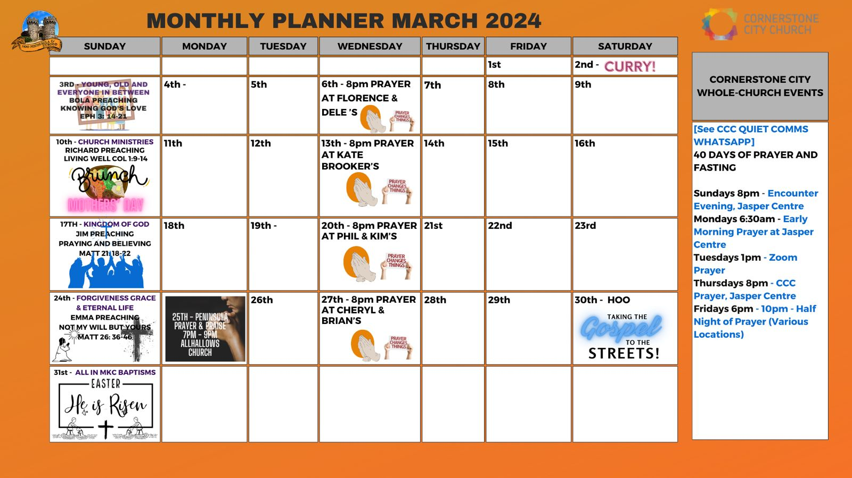

Slide 49


Slide 50
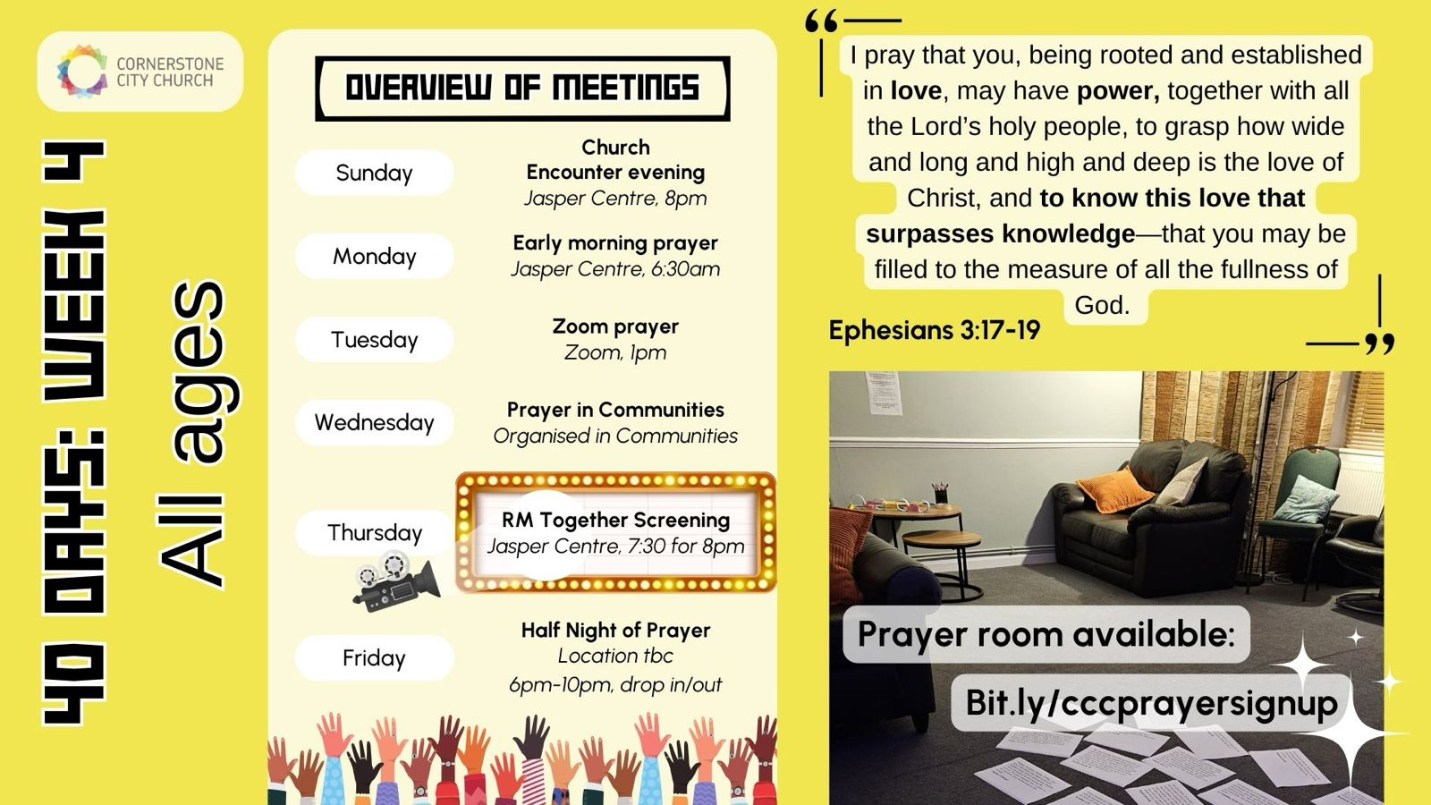

Slide 51


Slide 52


Slide 53


Slide 54
2 Corinthians 14 May the grace of the Lord Jesus Christ, and the love of God, and the fellowship of the Holy Spirit be with you all

